Slide 1
Event planner
PRESENTED BY:
Mr. BORDA KARTIK V. (4270)
Mr. CHAUDHARY YOGESH S. (4273)
Mr. GODHASARA HET J. (4303)
B.C.A 6th Semester Project

Slide 2
agenda
Introduction
Hardware & Software Requirements
Technology Used
Existing System
Need for the new system
Objective of system
Core components
Targeted users/roles
Data dictionary
E-R Diagram
Use case diagram
System design
Advantages and Disadvantages
System enhancement
Conclusion
References

Slide 3
INTRODUCTION
‘Event Planner’ is an idea that itself says that our project is about manage events online. User can register for the event provided by the Admin. User has choice to participants in multiple events, and Admin can manage events and users as well.

Slide 4
HARDWARE & SOFTWARE REQUIREMENTS

Slide 5
Hardware Requirements
Hardware Requirement | Description
Processor | Intel Core i5 8th gen
RAM | 8 GB
Storage | 256 GB SSD
Internet Connection | Required

Slide 6
Software Requirements
Software Requirement | Description
Operating System | Windows 11
Browser | Google Chrome, Microsoft Edge
Front-end | Laravel, Jquery, Bootstrap-Sass
Back-end | PHP
Database | MySQL
Development Tools | Microsoft Visual Studio Code

Slide 7
TECHNOLOGY USED

Slide 8
PHP
PHP is a general-purpose scripting language geared towards web development. It was originally created by Danish-Canadian programmer Rasmus Lerdorf in 1993 and released in 1995. PHP was originally an abbreviation of Personal Home Page, but it now stands for the recursive initialism PHP: Hypertext Preprocessor.
PHP is an amazing and popular language!
PHP code is executed on the server.
It is deep enough to run large social networks!
It is also easy enough to be a beginner's first server side language!
What Can PHP Do?
PHP can generate dynamic page content.
PHP can create, open, read, write, delete, and close files on the server.
PHP can send and receive cookies

Slide 9
LARAVEL
Laravel is a free and open-source PHP web framework, created by Taylor Otwell and intended for the development of web applications following the model–view–controller (MVC) architectural pattern and based on Symfony. Some of the features of Laravel are a modular packaging system with a dedicated dependency manager, different ways for accessing relational databases, utilities that aid in application deployment and maintenance,and its orientation toward syntactic sugar.
Advantages of Laravel
The web application becomes more scalable, owing to the Laravel framework.
Considerable time is saved in designing the web application, since Laravel reuses the components from other framework in developing web application.
Feature of Laravel
Authentication
Testability
Routing
Configuration Management
Template Engine

Slide 10
JQUERY
jQuery is a JavaScript library designed to simplify HTML DOM tree traversal and manipulation, as well as event handling, CSS animations, and Ajax. It is free, open-source software using the permissive MIT License.
As of August 2022, jQuery is used by 77% of the 10 million most popular websites. Web analysis indicates that it is the most widely deployed JavaScript library by a large margin, having at least three to four times more usage than any other JavaScript library.
Why JQuery
There are lots of other JavaScript libraries out there, but jQuery is probably the most popular, and also the most extendable.
jQuery is a lightweight, "write less, do more", JavaScript library.

Slide 11
Existing system
Nowadays, College Campus handled events manually, so all kind of events are handling manually in paper work by each branch, and Its complicated to manage record of particular events. There is no system to check the past expenses on any event. To do this they have to check register and this task is very time consuming and tiresome.

Slide 12
NEED FOR THE NEW SYSTEM
As an Existing system providing a functionality to handle Shree Uttar Gujarat BCA College manually but there should be functionality to manage it online. This provides a single platform that can be used to handle several College Campus Events of different branches like Business and Computer Science Event, Sport Event of College Campus of BCA department.

Slide 13
OBJECTIVES OF SYSTEM
To manage user’s role, Groups, events, sub events of events, users.
To handle different Branches, Streams and Divisions.
To Manage Guests, Guests invitations, Reminders to guests for specific event, Events Venues, Events Expense, Sub Events Expense, Total Expense.
Dynamic scheduling Generation for Sub Events and Attendance Management for Specific Event Scheduling, Notification Reminder to Student for practice Schedule.
To Manage Previous Year Events records, To Manage Prize Distribution of VNSGU Rankers.

Slide 14
CORE COMPONENTS
Manage Users
Manage Events
Manage Sub-Events
Manage Branches
Manage Role
Manage Venue
Manage Attendance
Manage Practice Session Scheduling
Manage Event Registration
Manage Scheduling
Manage Expense
Manage Invitation
Manage Guest
Registration
Login
Change / Forgot Password

Slide 15
Targeted users/roles
Users | Functionality
Admin | Manage Users, Manage Events, Manage Sub-Events, Manage Branches, Manage Role, Manage Venue, Manage Attendance, Manage Expense, Manage Scheduling, Manage Practice Session Scheduling, Manage Event Registration, Manage Invitation, Manage Guest
Event Handler | Manage Event Registration, Manage Expense, Manage Scheduling, Manage Practice Session Scheduling
Faculty Coordinator | Add Expense, Add Attendance
Student | Registration for Event
Student Coordinator | Registration for Event, Add Expense, Add Attendance

Slide 16
DATA DICTIONARY

Slide 17
Sr No | Table Name
1 | Branch Master
2 | Venue
3 | Role
4 | Guest
5 | Stream Master
6 | Division Master
7 | Event Master
8 | Sub-Event Master
9 | User Master
10 | Choreographer
11 | Event Registration
12 | Group
13 | Expense
14 | Costume
15 | Practice Schedule
16 | Attendance
17 | Invitation
18 | Scheduling

Slide 18
BRANCH MASTER
Field Name | Data Type | Constraint | Description | Sample Data
B_ID | INT(7) | PK | Unique Branch id | 1
B_CODE | INT(7) | NOT NULL | Code of the Branch | 517
B_NAME | VARCHAR(20) | NOT NULL | Name of the Branch | MCA
VENUE
Field Name | Data Type | Constraint | Description | Sample Data
V_ID | INT(7) | PK | Unique Venue id | 1
V_NAME | VARCHAR(20) | NOT NULL | Name of the Venue | Tagor Hall
V_ADDRESS | VARCHAR(100) | NOT NULL | Address of the Venue | Near iscon temple

Slide 19
ROLE
Field Name | Data Type | Constraint | Description | Sample Data
R_ID | INT(7) | PK | Unique Role id | 1
R_NAME | VARCHAR(20) | NOT NULL | Name of the Role | Student Coordinator
GUEST
Field Name | Data Type | Constraint | Description | Sample Data
GUEST_ID | INT(7) | PK | Unique Guest id | 1
FULL_NAME | VARCHAR(20) | NOT NULL | Full name of the Guest | Vijaybhai Rupani
MOBILE | VARCHAR(10) | UNIQUE | Guest Mobile number | 8526932541
EMAIL | VARCHAR(25) | UNIQUE | Guest Email id | Vijay@gmail.com

Slide 20
STREAM MASTER
Field Name | Data Type | Constraint | Description | Sample Data
S_ID | INT(7) | PK | Unique Stream id | 1
B_ID | INT(7) | FK | Reference to Branch Id | 1
S_NAME | VARCHAR(20) | NOT NULL | Stream name | MCA
DIVISION MASTER
Field Name | Data Type | Constraint | Description | Sample Data
D_ID | INT(7) | PK | Unique Division id | 1
S_ID | INT(7) | FK | Reference to Stream Id | 1
D_NAME | VARCHAR(20) | NOT NULL | Division name | C

Slide 21
EVENT MASTER
Field Name | Data Type | Constraint | Description | Sample Data
E_ID | INT(7) | PK | Unique Event id | 1
B_ID | INT(7) | FK | Reference to Branch Id | 1
V_ID | INT(7) | FK | Reference to Venue Id | 1
E_NAME | VARCHAR(20) | NOT NULL | Name of the Event | Enthusia
E_DURATION | TIME | NOT NULL | Duration of the Event | 6 hours
E_DESCRIPTION | VARCHAR(255) | NOT NULL | Description of Event | Annual function
E_STATUS | INT(1) | NOT NULL | Event Status | 0
START_DATE | DATE | NOT NULL | Event Start Date | 25/2/2020
END_DATE | DATE | NOT NULL | Event End Date | 25/2/2020

Slide 22
SUB EVENT MASTER
Field Name | Data Type | Constraint | Description | Sample Data
S_E_ID | INT(7) | PK | Unique Sub Event id | 1
E_ID | INT(7) | FK | Reference to Event table | 1
S_E_NAME | VARCHAR(50) | NOT NULL | Name of the Sub Event | Ramp Walk
DESCRIPTION | VARCHAR(255) | NOT NULL | Description of Sub Event | Ramp Walk
DURATION | TIME | NOT NULL | Duration of Sub Event | 4 min
STATUS | INT(1) | NOT NULL | Status of Sub Event | Active

Slide 23
CHOREOGRAPHER
Field Name | Data Type | Constraint | Description | Sample Data
C_ID | INT(7) | PK | Unique Choreographer id | 1
S_E_ID | INT(7) | FK | Reference to Sub Event table | 1
C_NAME | VARCHAR(50) | NOT NULL | Name of the Choreographer | KARTIK
C_MOBILE | VARCHAR(13) | UNIQUE | Choreographer Contact no. | 8987009872
C_EMAIL | VARCHAR(70) | UNIQUE | Choreographer Email id | kartik@gmail.com

Slide 24
EVENT REGISTRATION
Field Name | Data Type | Constraint | Description | Sample Data
E_R_ID | INT(7) | PK | Unique Event Register id | 1
S_E_ID | INT(7) | FK | Reference to Sub Event table | 1
U_ID | INT(7) | FK | Reference to User table | 1
R_ID | INT(7) | FK | Reference to Role table | 1
G_ID | INT(7) | FK | Reference to Group table | 1
STATUS | INT(1) | NOT NULL | Event Status for Registration | Active

Slide 25
GROUP
Field Name | Data Type | Constraint | Description | Sample Data
G_ID | INT(7) | PK | Unique Group id | 1
E_ID | INT(7) | FK | Reference to Event table | 1
U_ID | INT(7) | FK | Reference to User table | 1
S_E_ID | INT(7) | FK | Reference to Sub Event table | 1
R_ID | INT(7) | FK | Reference to Role table | 1

Slide 26
EXPENSE
Field Name | Data Type | Constraint | Description | Sample Data
EXPENCE_ID | INT(7) | PK | Unique Expense id | 1
E_ID | INT(7) | FK | Reference to Event table | 1
S_E_ID | INT(7) | FK | Reference to Sub Event table | 1
U_ID | INT(7) | FK | Reference to User table | 1
NAME | VARCHAR(30) | NOT NULL | Name of the Expense | Snacks
EXPENSE | INT(7) | NOTNULL | Amount of expense | 3000
DESCRIPTION | VARCHAR(255) | NOT NULL | Expense Description | Snacks
STATUS | INT(1) | NOT NULL | Expense Status | Active

Slide 27
COSTUME
Field Name | Data Type | Constraint | Description | Sample Data
COSTUME_ID | INT(7) | PK | Unique Costume id | 1
S_E_ID | INT(7) | FK | Reference to Sub Event table | 1
U_ID | INT(7) | FK | Reference to User table | 1
ISSUE_DATE | DATE | NOT NULL | Issue Date of Costume | 1/2/2020
RETURN_DATE | DATE | NULL | Return Date of Costume | null
STATUS | INT(1) | NOT NULL | Status of Costume | Not Returned

Slide 28
PRACTICE SCHEDULE
Field Name | Data Type | Constraint | Description | Sample Data
P_ID | INT(7) | PK | Unique Practice Schedule id | 1
S_E_ID | INT(7) | FK | Reference to Sub Event table | 1
E_R_ID | INT(7) | FK | Reference to Event Register table | 1
U_ID | INT(7) | FK | Reference to User table | 1
DESCRIPTION | VARCHAR(255) | NOTNULL | Practice Schedule Description | Ramp Walk
TIME | TIME | NOT NULL | Practice Schedule Time | 4:00 PM
DATE | DATE | NOT NULL | Practice Schedule Date | 10/2/2020

Slide 29
ATTENDANCE
Field Name | Data Type | Constraint | Description | Sample Data
A_ID | INT(7) | PK | Unique Attendance id | 1
U_ID | INT(7) | FK | Reference to User table | 1
S_E_ID | INT(7) | FK | Reference to Sub Event table | 1
PRESENT | JSON | NOT NULL | Present mark in Attendance | YES
DATE | DATE | NOT NULL | Date of Attendance taken | 5/2/2020

Slide 30
GUEST INVITATION
Field Name | Data Type | Constraint | Description | Sample Data
I_ID | INT(7) | PK | Unique Invitation id | 1
E_ID | INT(7) | FK | Reference to Event table | 1
GUEST_ID | INT(7) | FK | Reference to Guest table | 1
DESCRIPTION | JSON | NOT NULL | Description of Event Invitation | Event Invitation
DATE | DATE | NOT NULL | Date of Invitation | 7/2/2020
SCHEDULING
Field Name | Data Type | Constraint | Description | Sample Data
SCHED_ID | INT(7) | PK | Unique Scheduling id | 1
E_ID | INT(7) | FK | Reference to Event table | 1
DETAILS | JSON | NOT NULL | Details of Scheduling | Event Scheduling
TIME | TIME | NOT NULL | Time of Generating Schedule | 5.38 PM

Slide 31
E-R Diagram

Slide 32
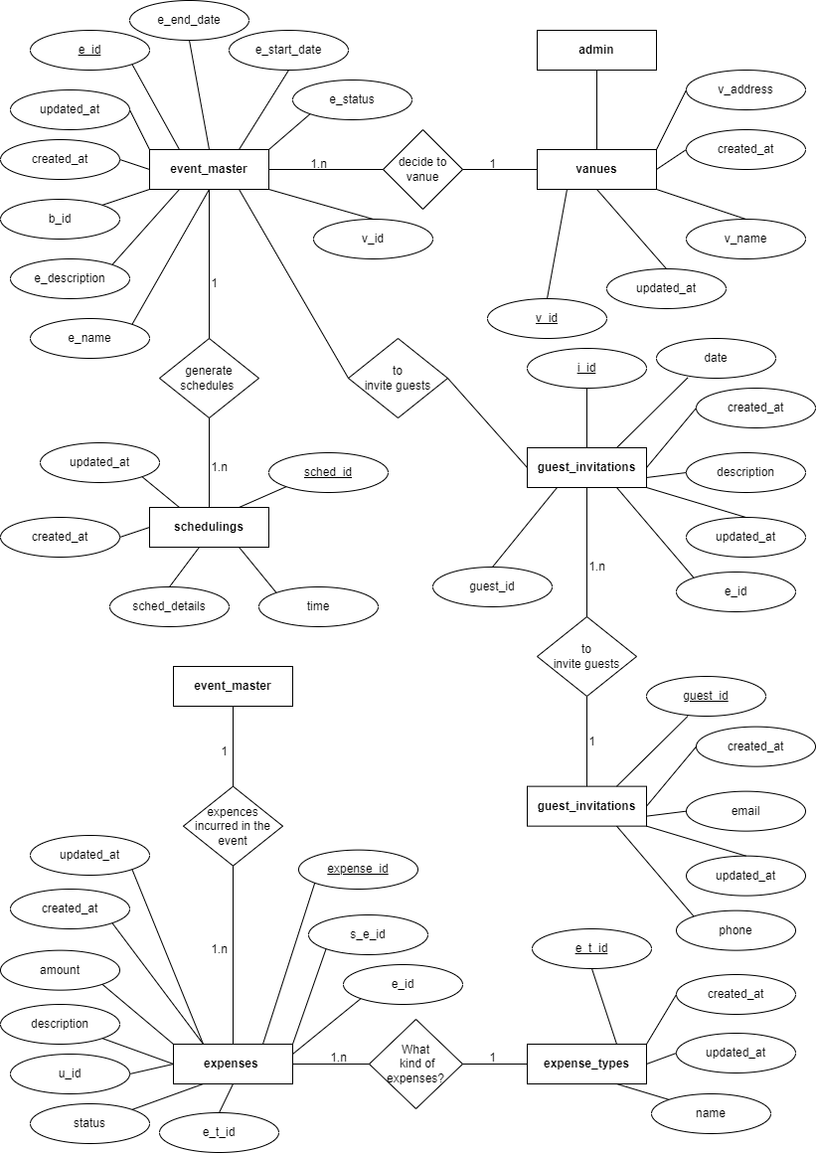

Slide 33
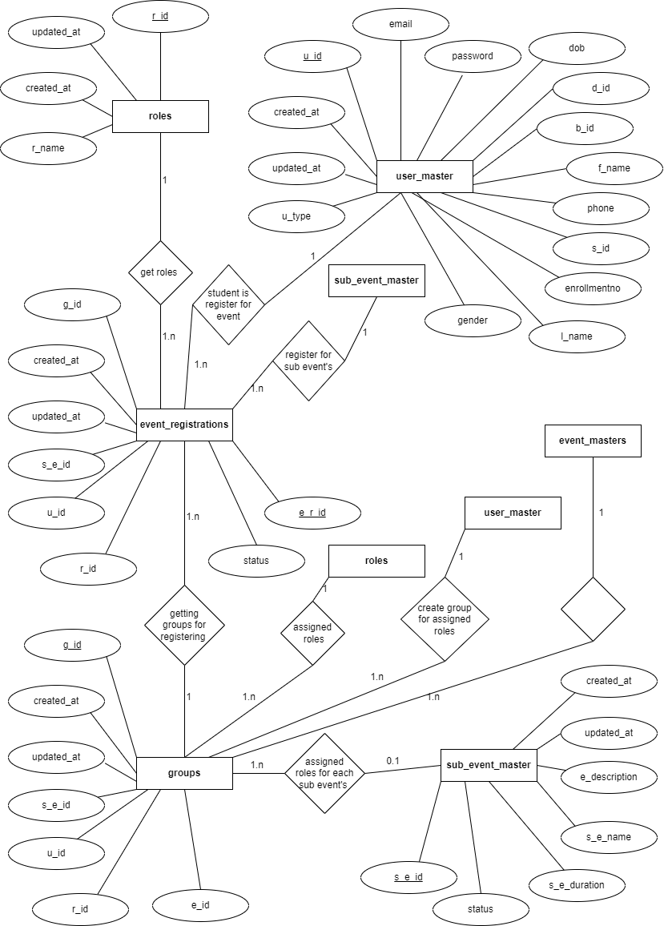

Slide 34
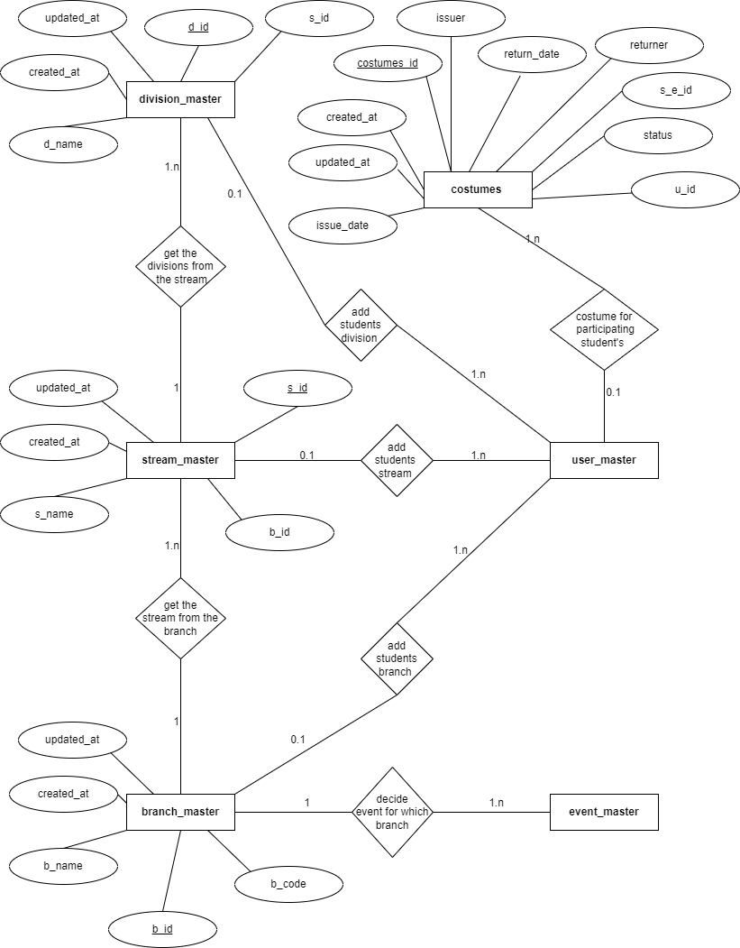

Slide 35
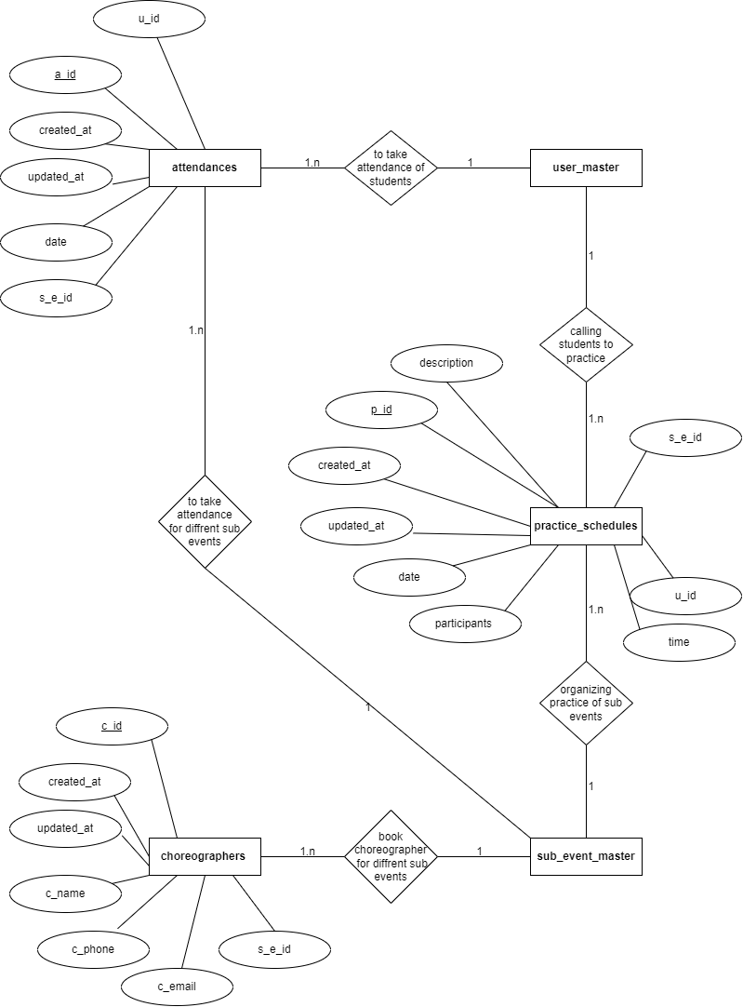

Slide 36
USE CASE DIAGRAME

Slide 37
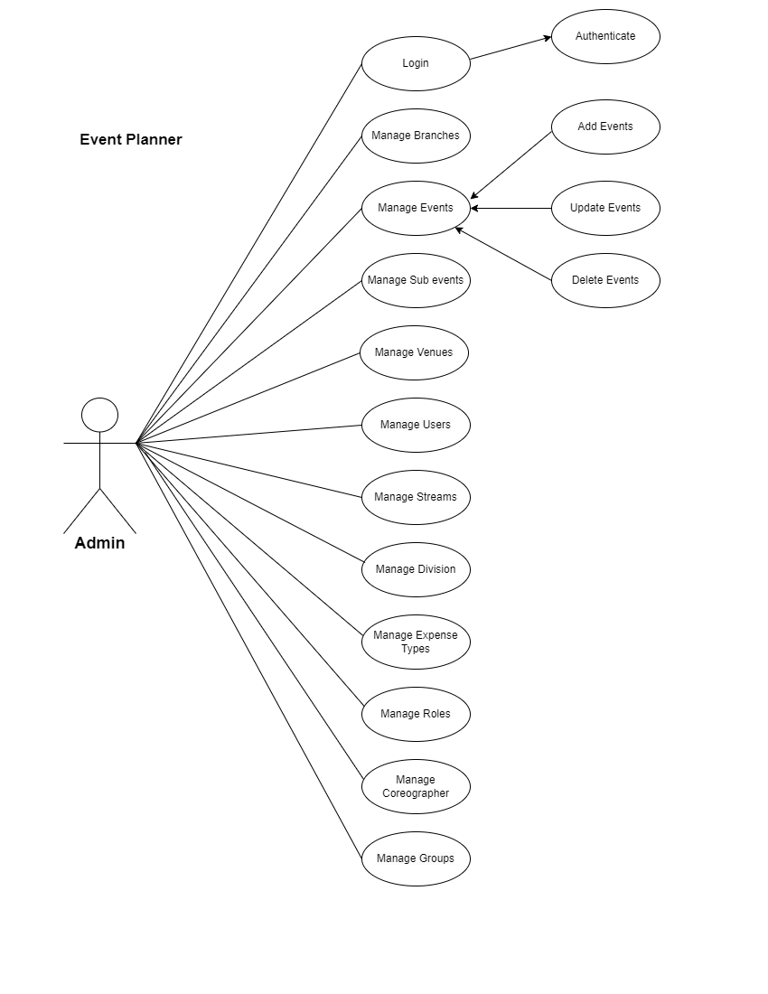

Slide 38
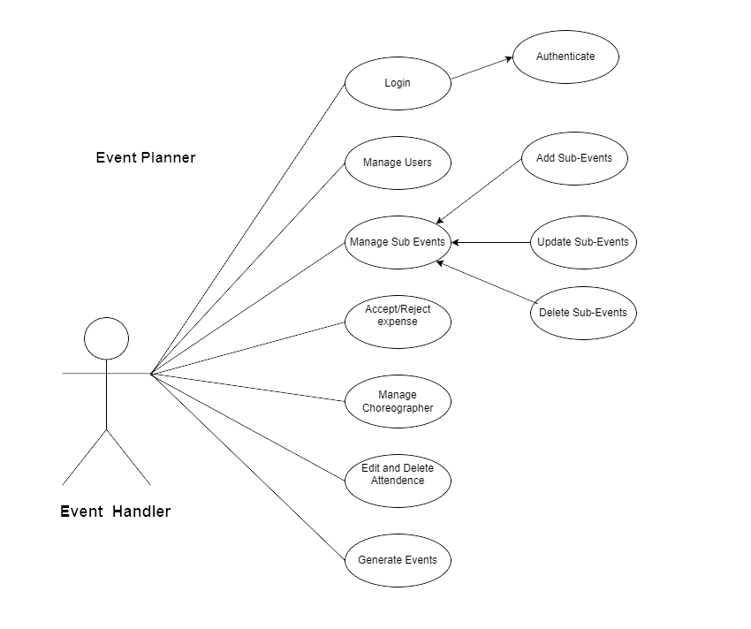

Slide 39
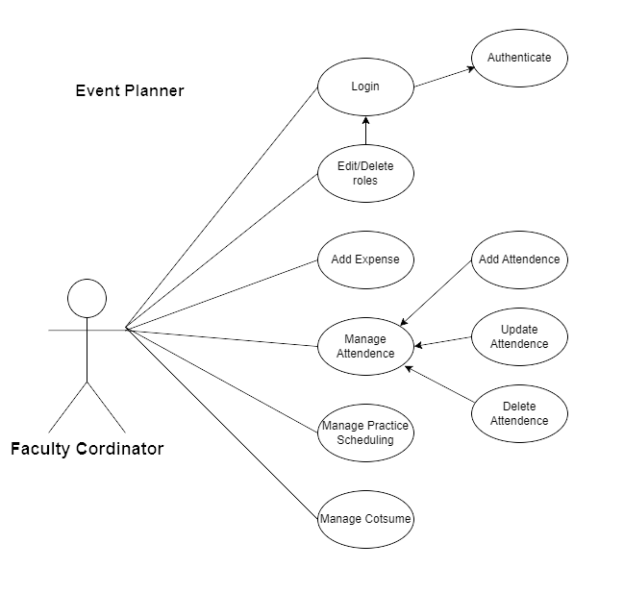

Slide 40
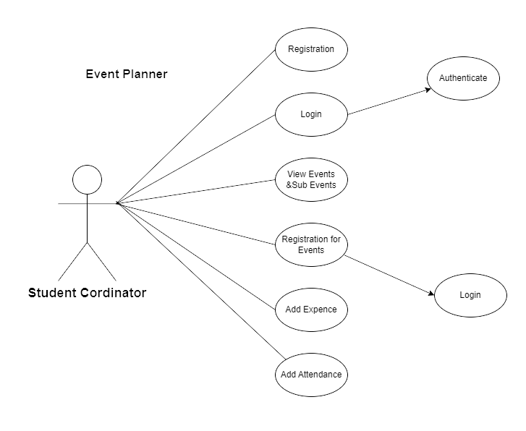

Slide 41
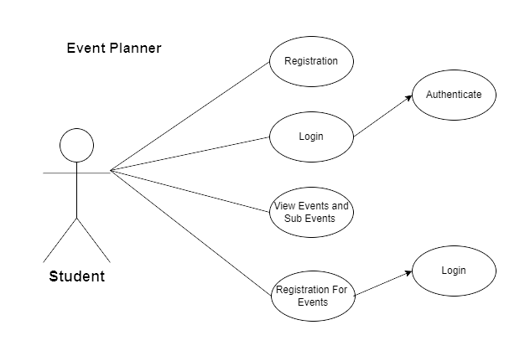

Slide 42
system design

Slide 43
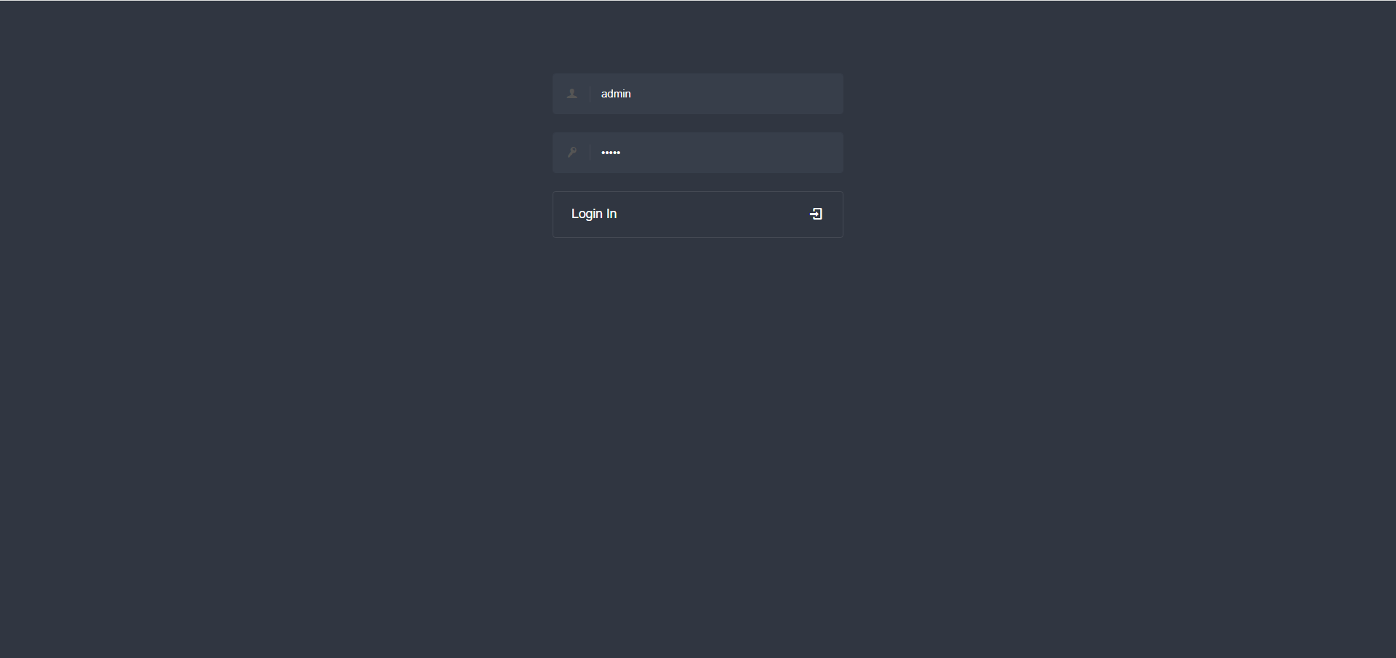
Admin
Login

Slide 44
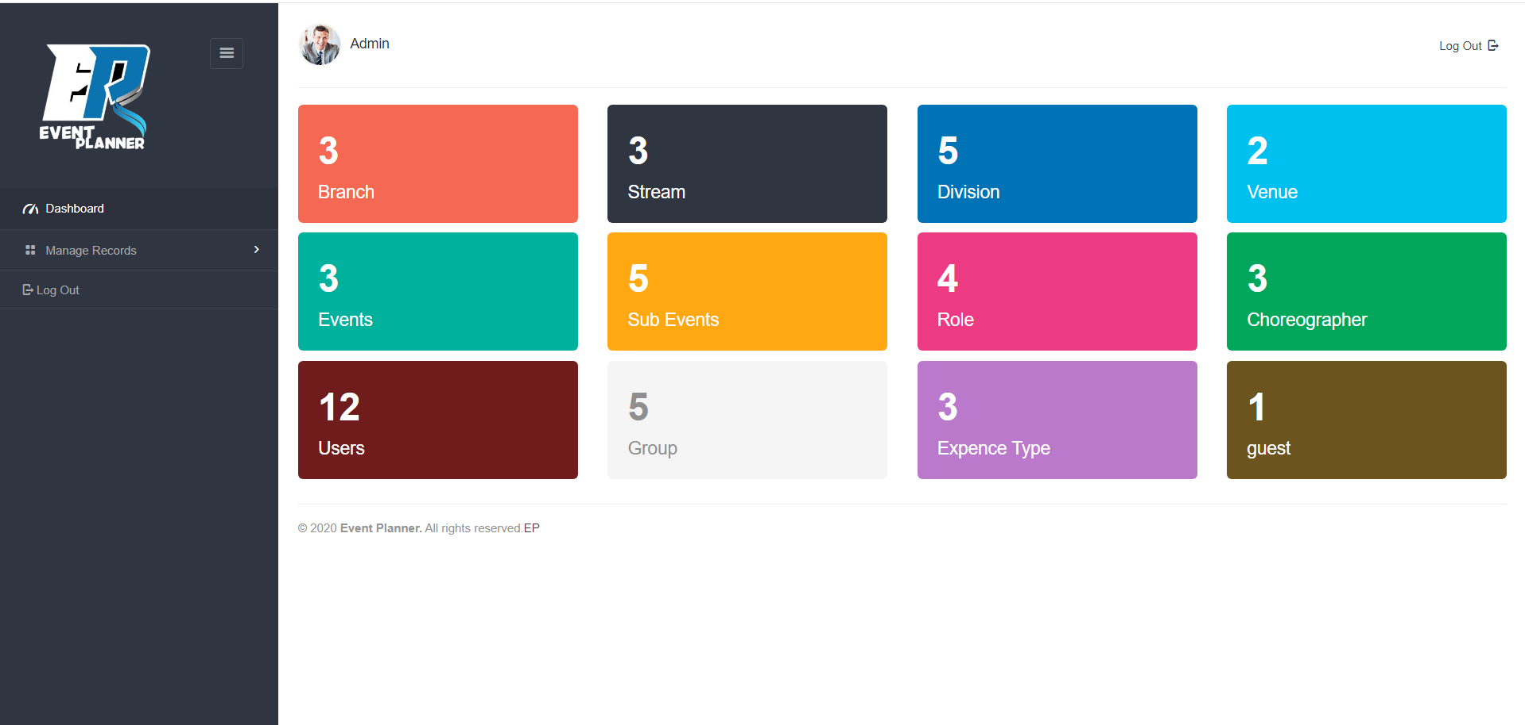
Dashboard

Slide 45
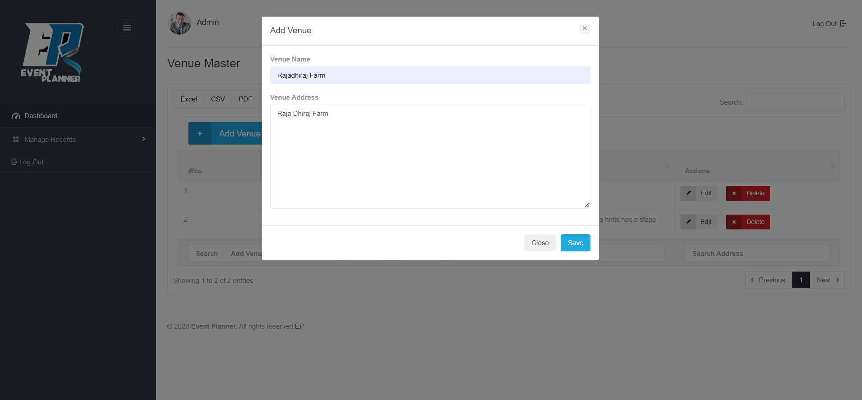
Add Records

Slide 46
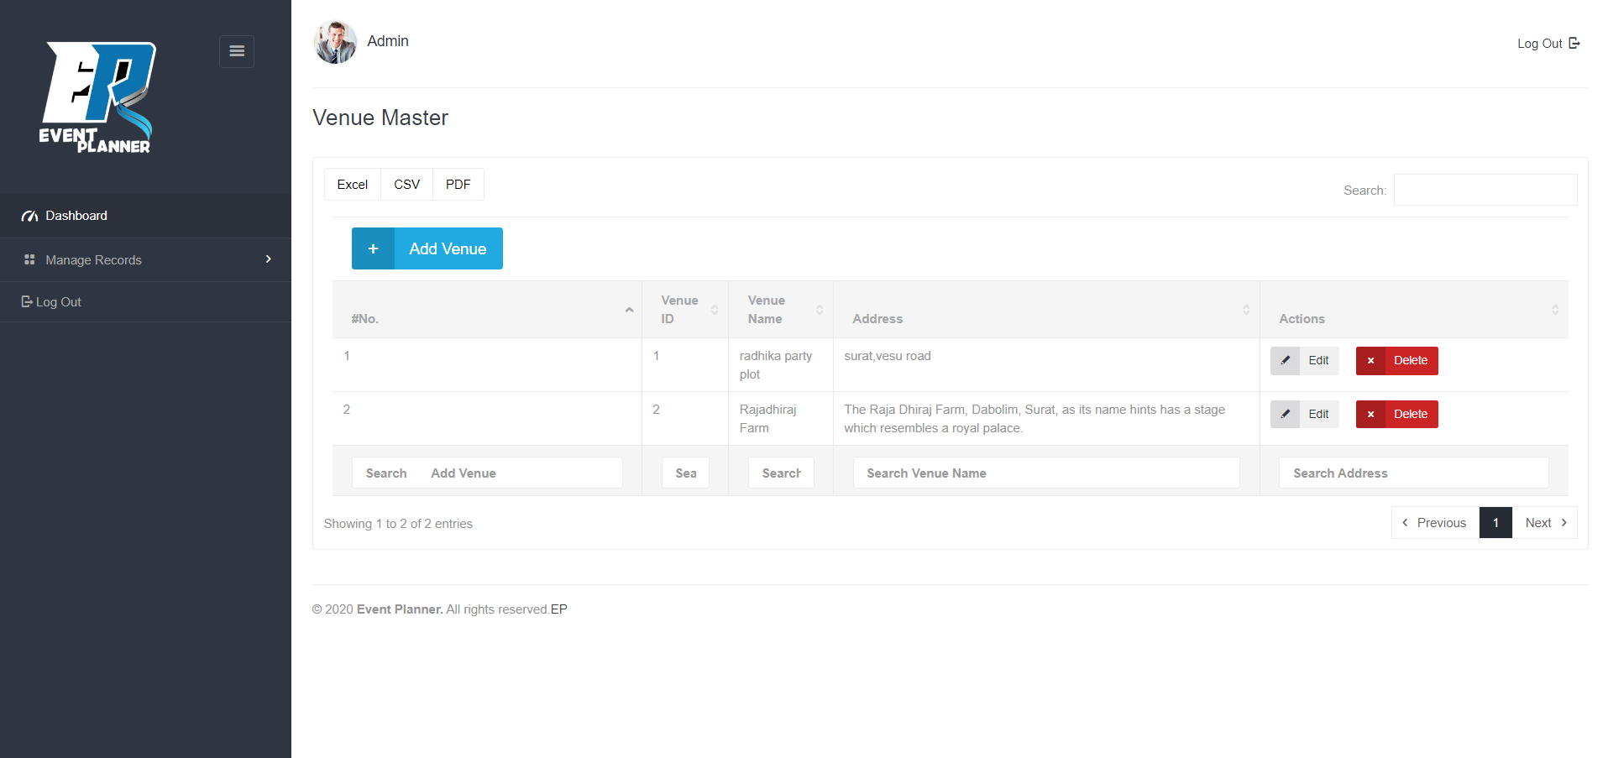
View Records

Slide 47
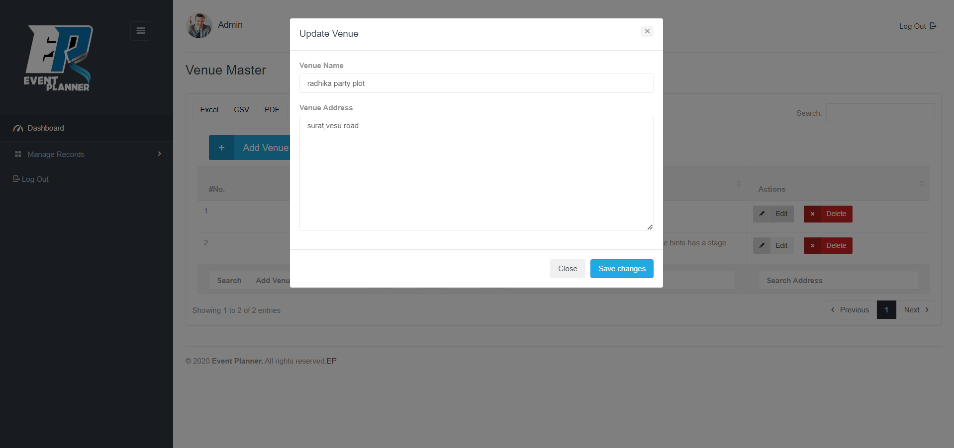
Update Records

Slide 48
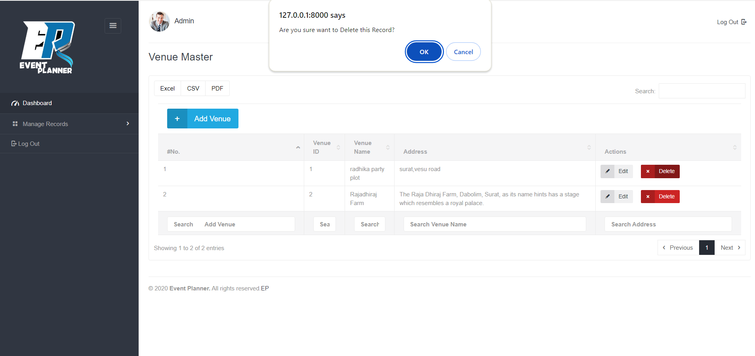
Delete Records

Slide 49
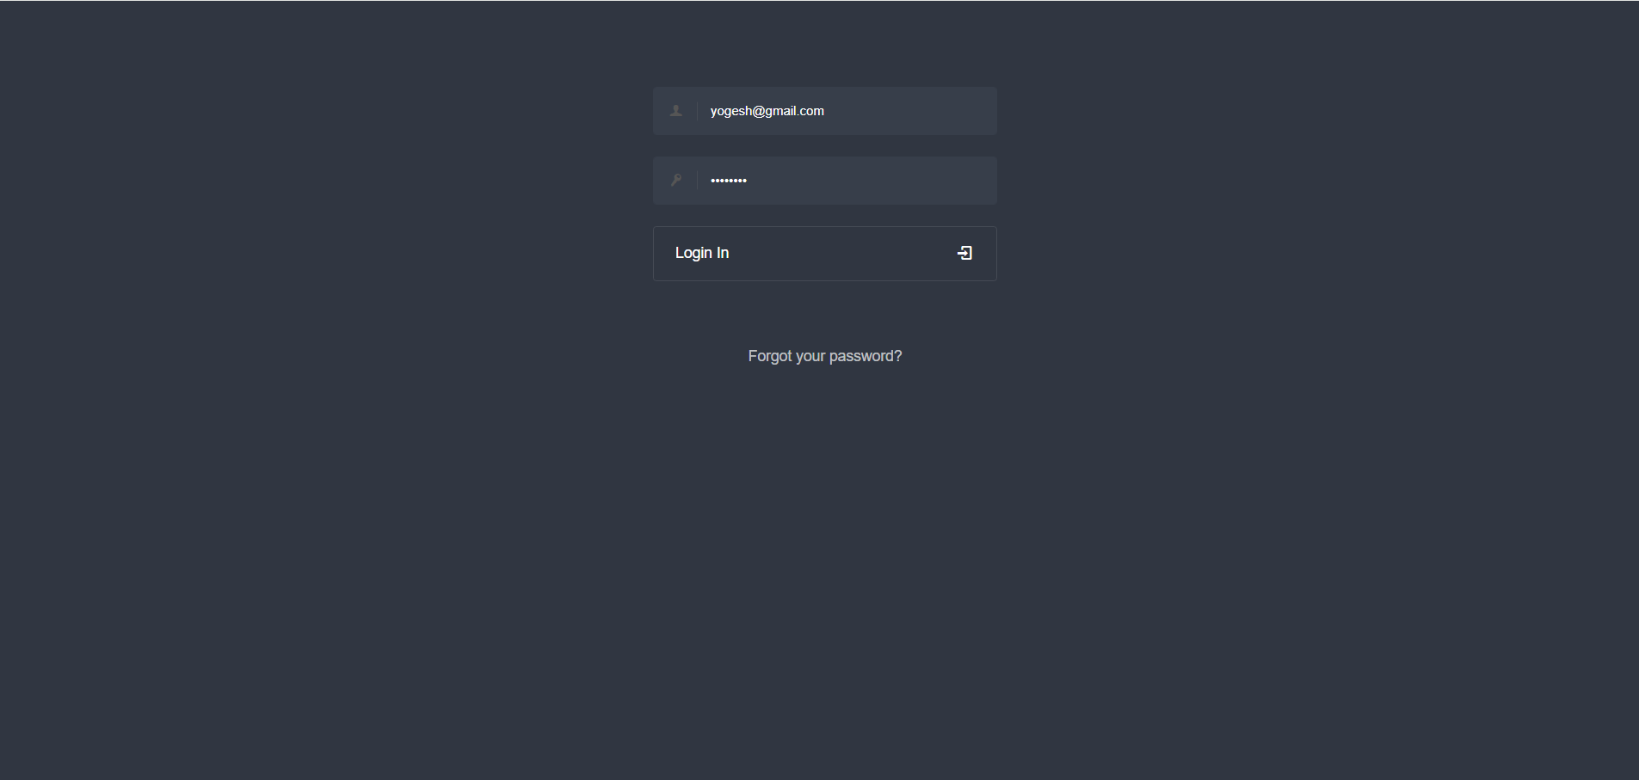
Event Handler
Login

Slide 50
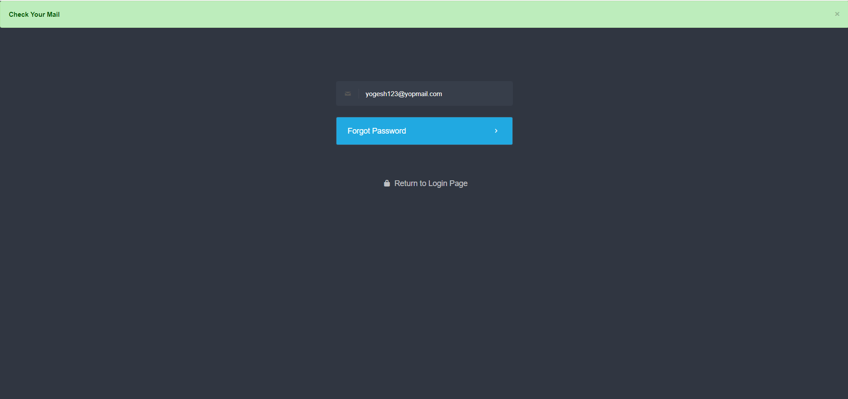
Forgot Password

Slide 51
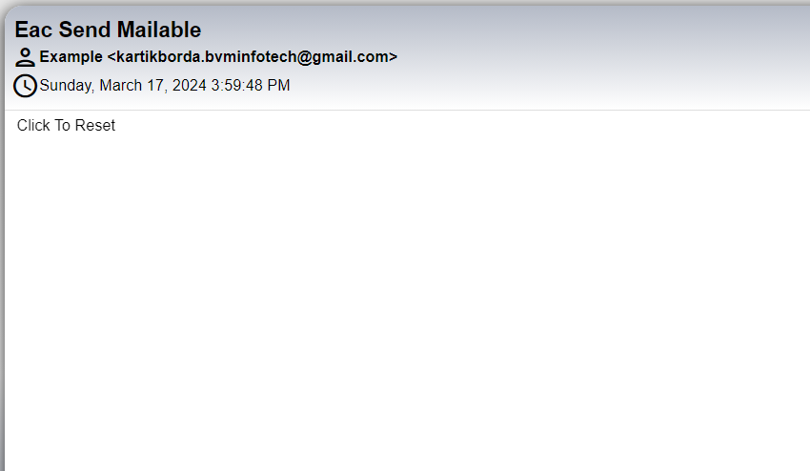
Sent Mail

Slide 52
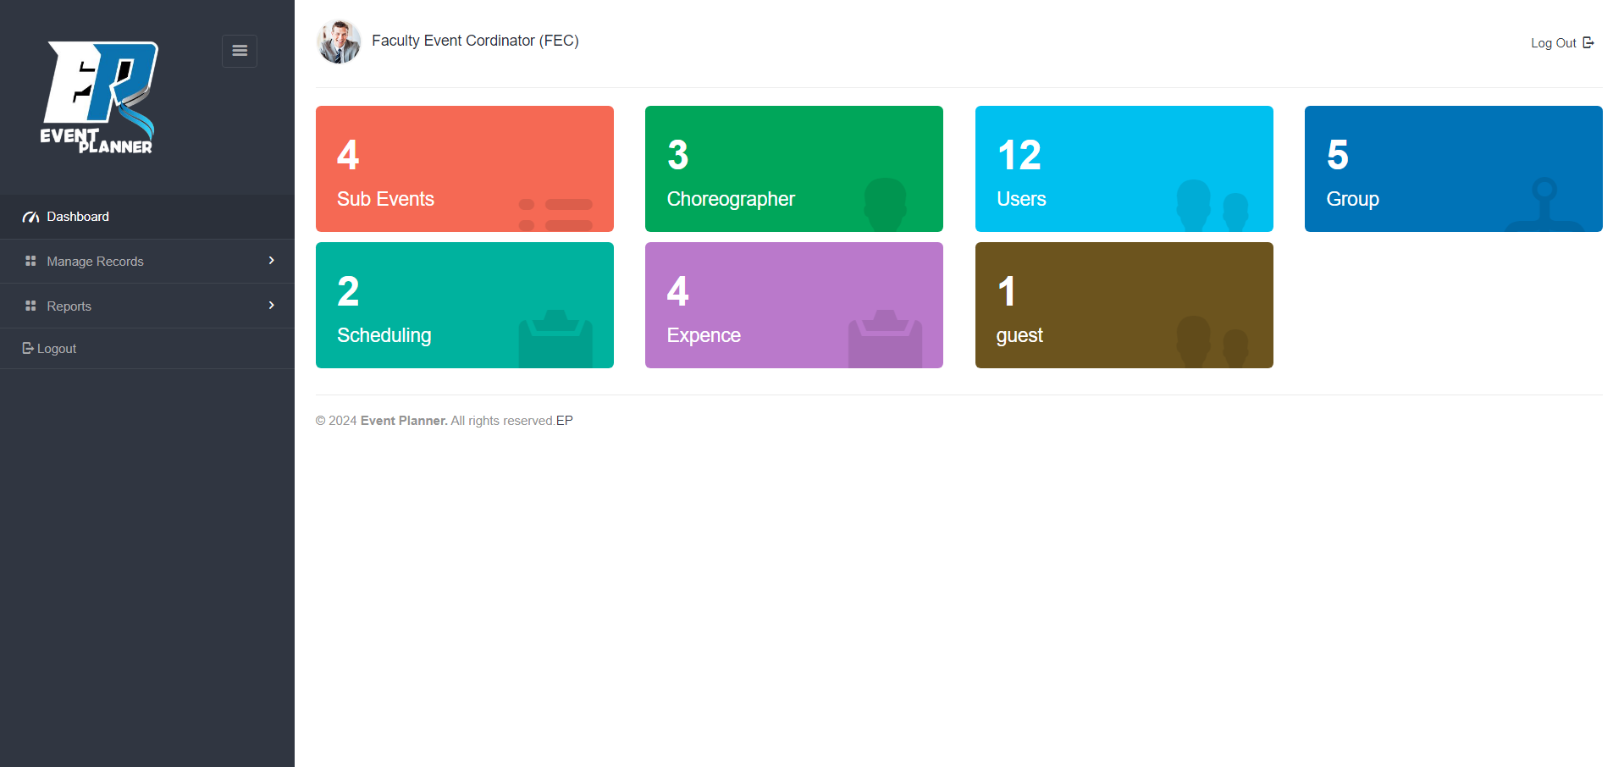
Dashboard

Slide 53
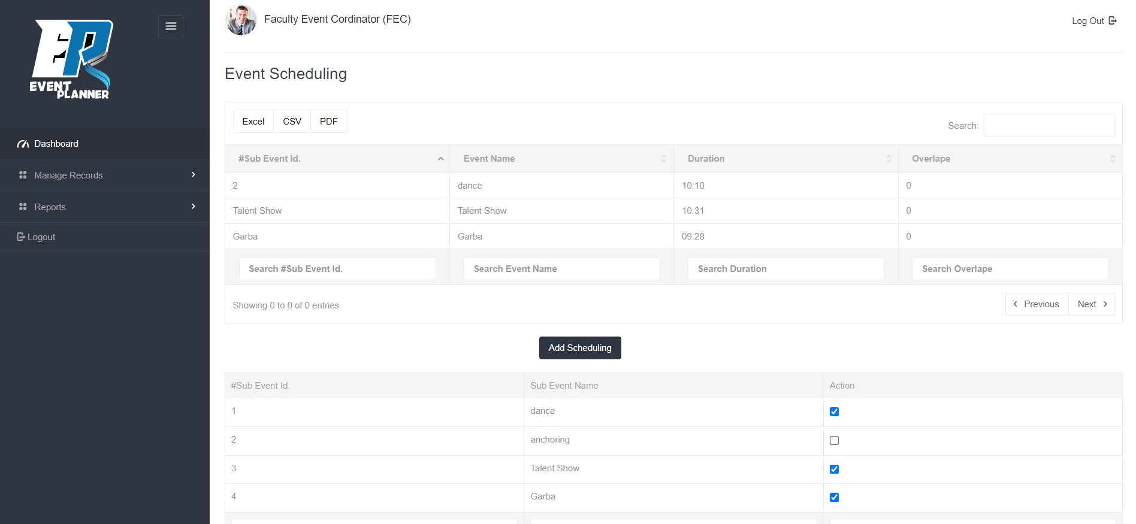
Generate Scheduling

Slide 54
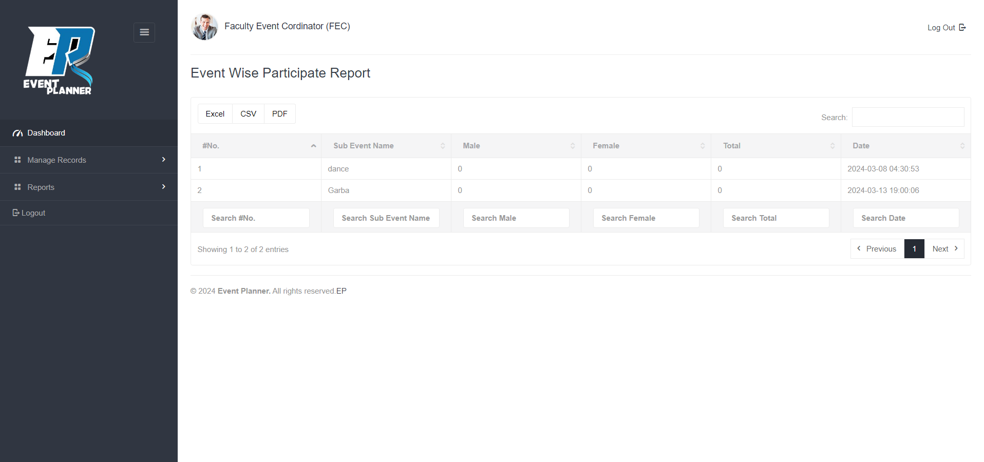
Reports
Event Wise Participate Report

Slide 55
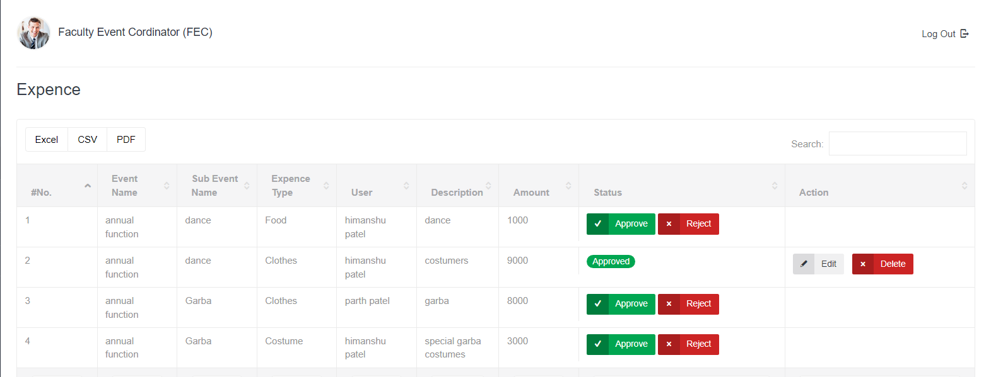
Expense Approve and Reject

Slide 56
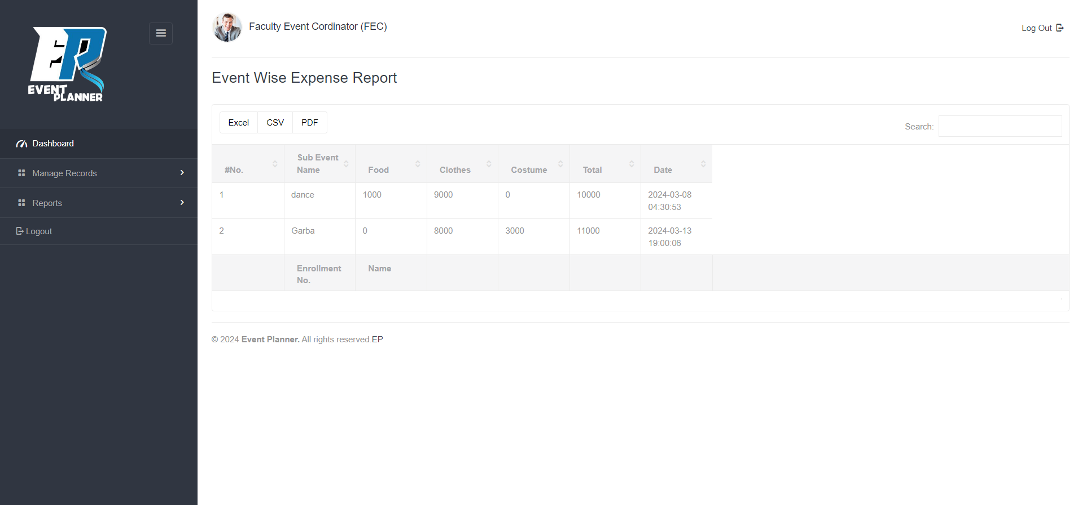
Event Wise Expense Report

Slide 57

Faculty Coordinator
Login

Slide 58
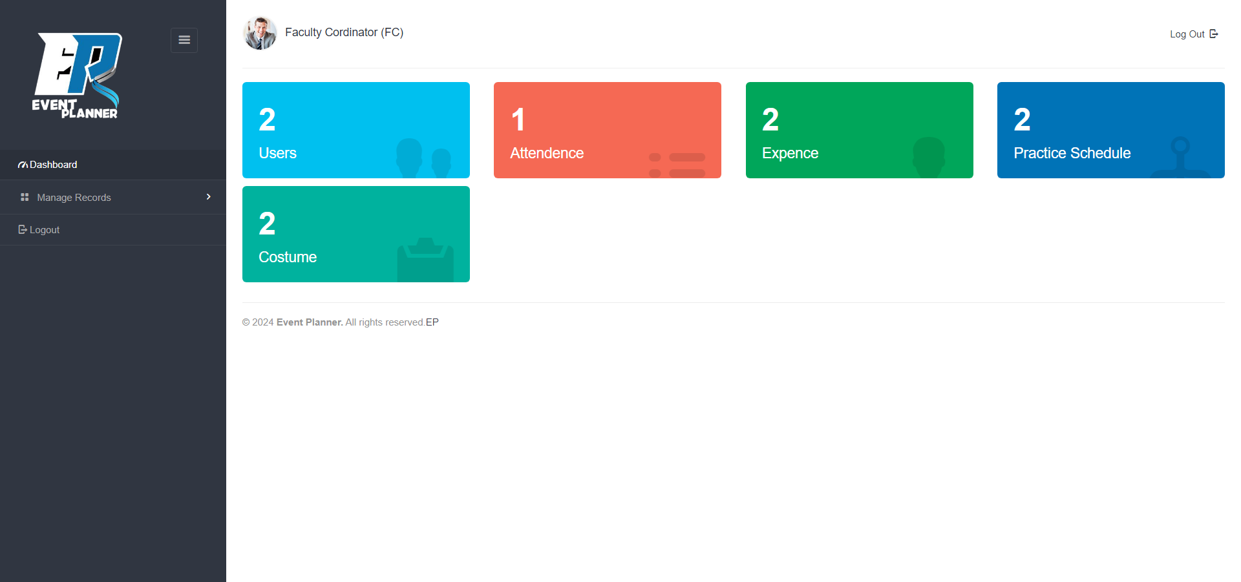
Dashboard

Slide 59
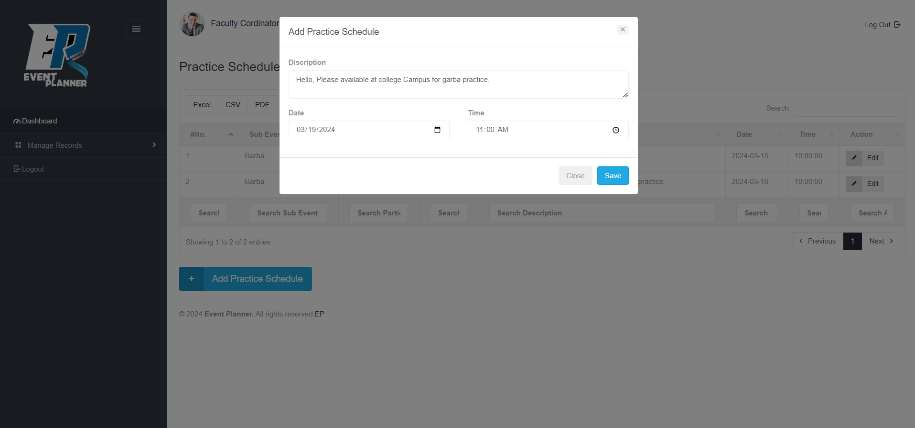
Practice Scheduling

Slide 60
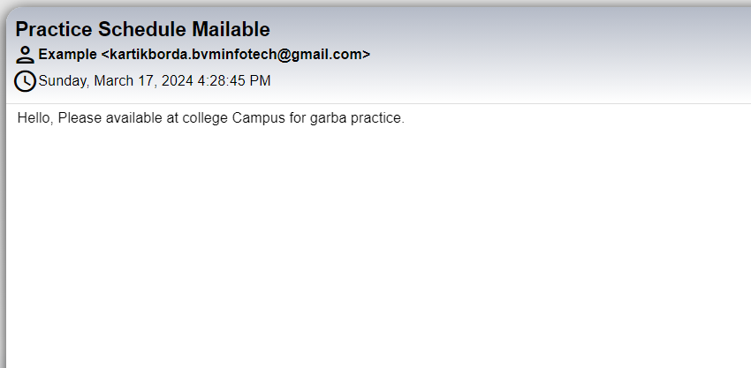
Sent Mail to Participants Student’s

Slide 61
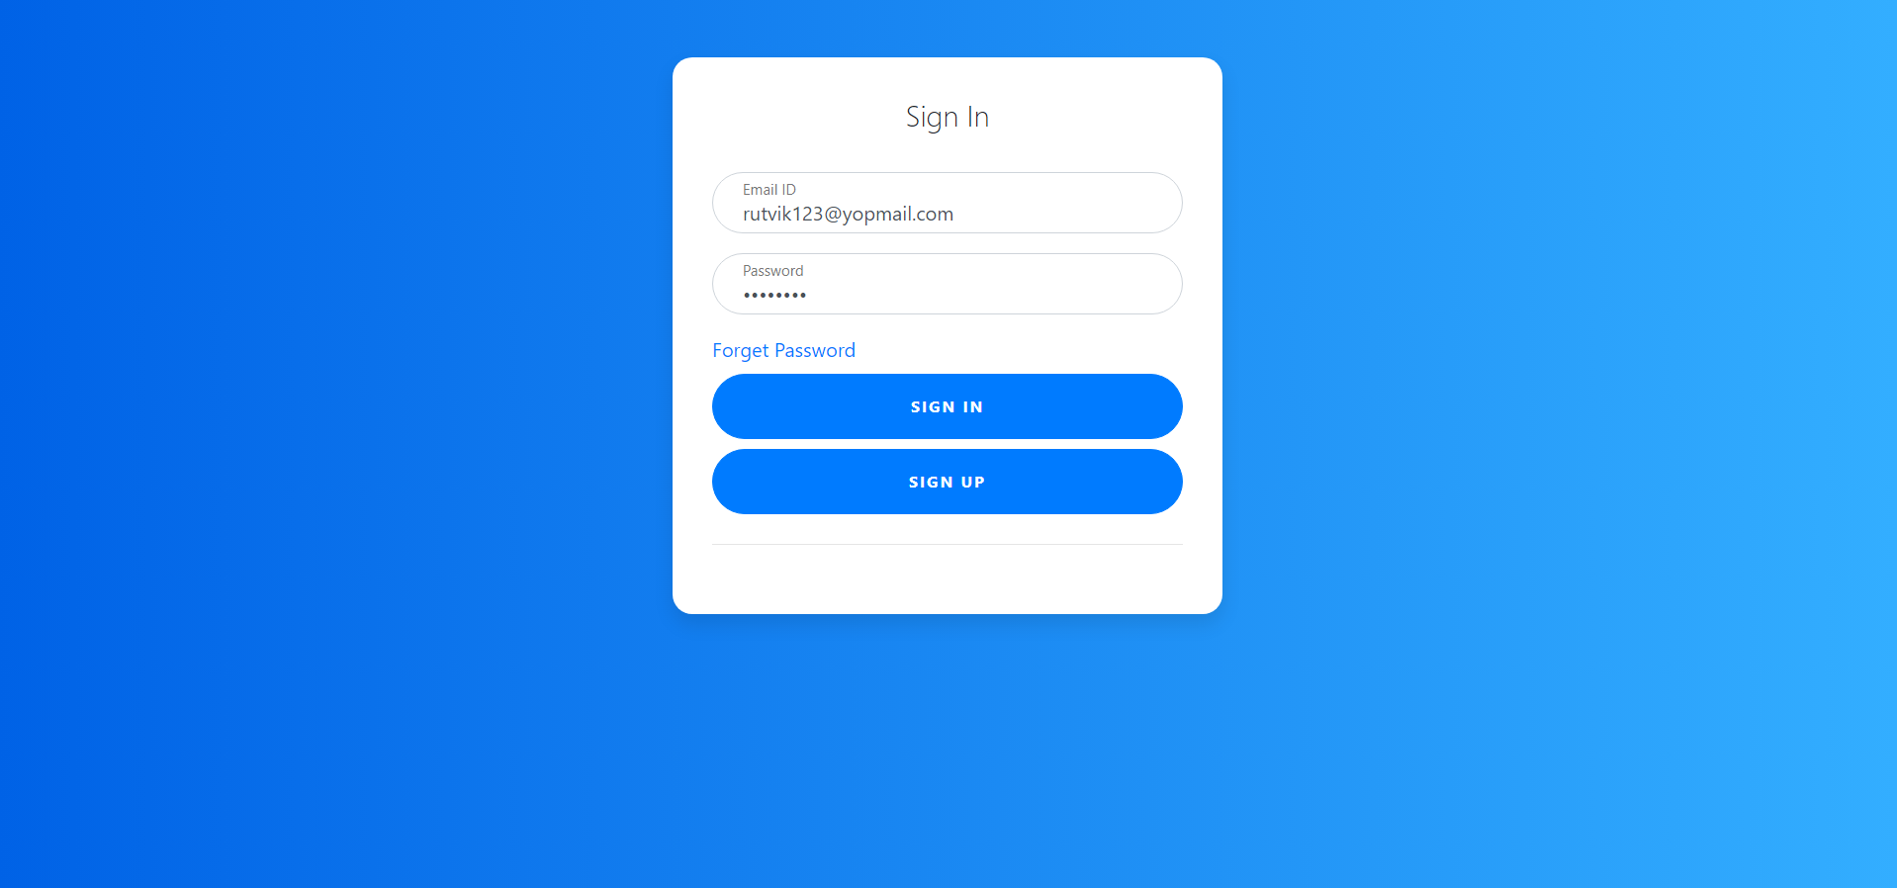
Student Coordinator
Login

Slide 62
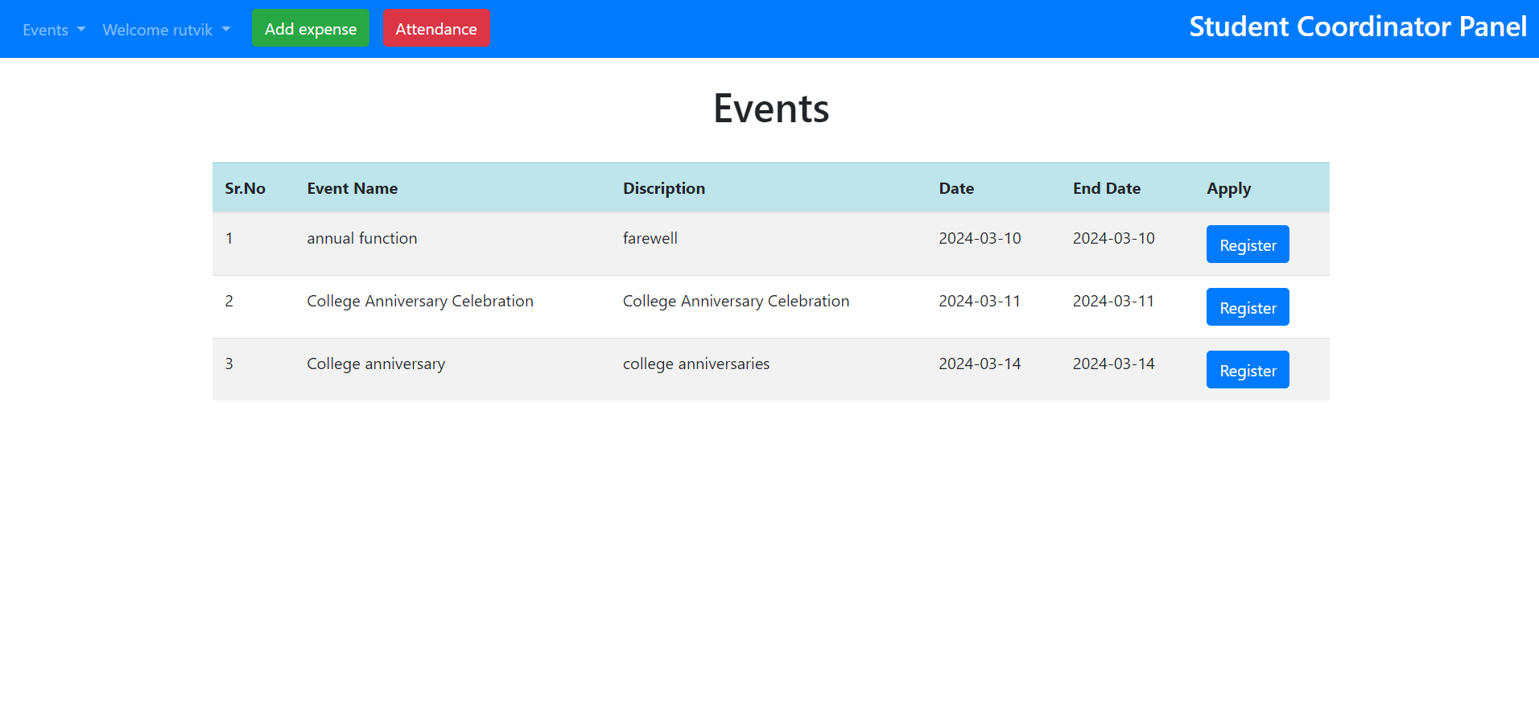
View All Events

Slide 63
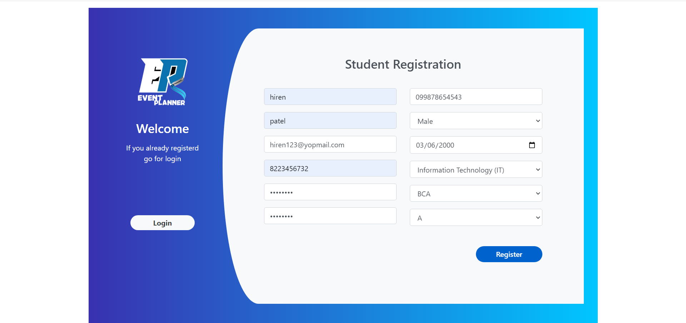
Students
Registration

Slide 64
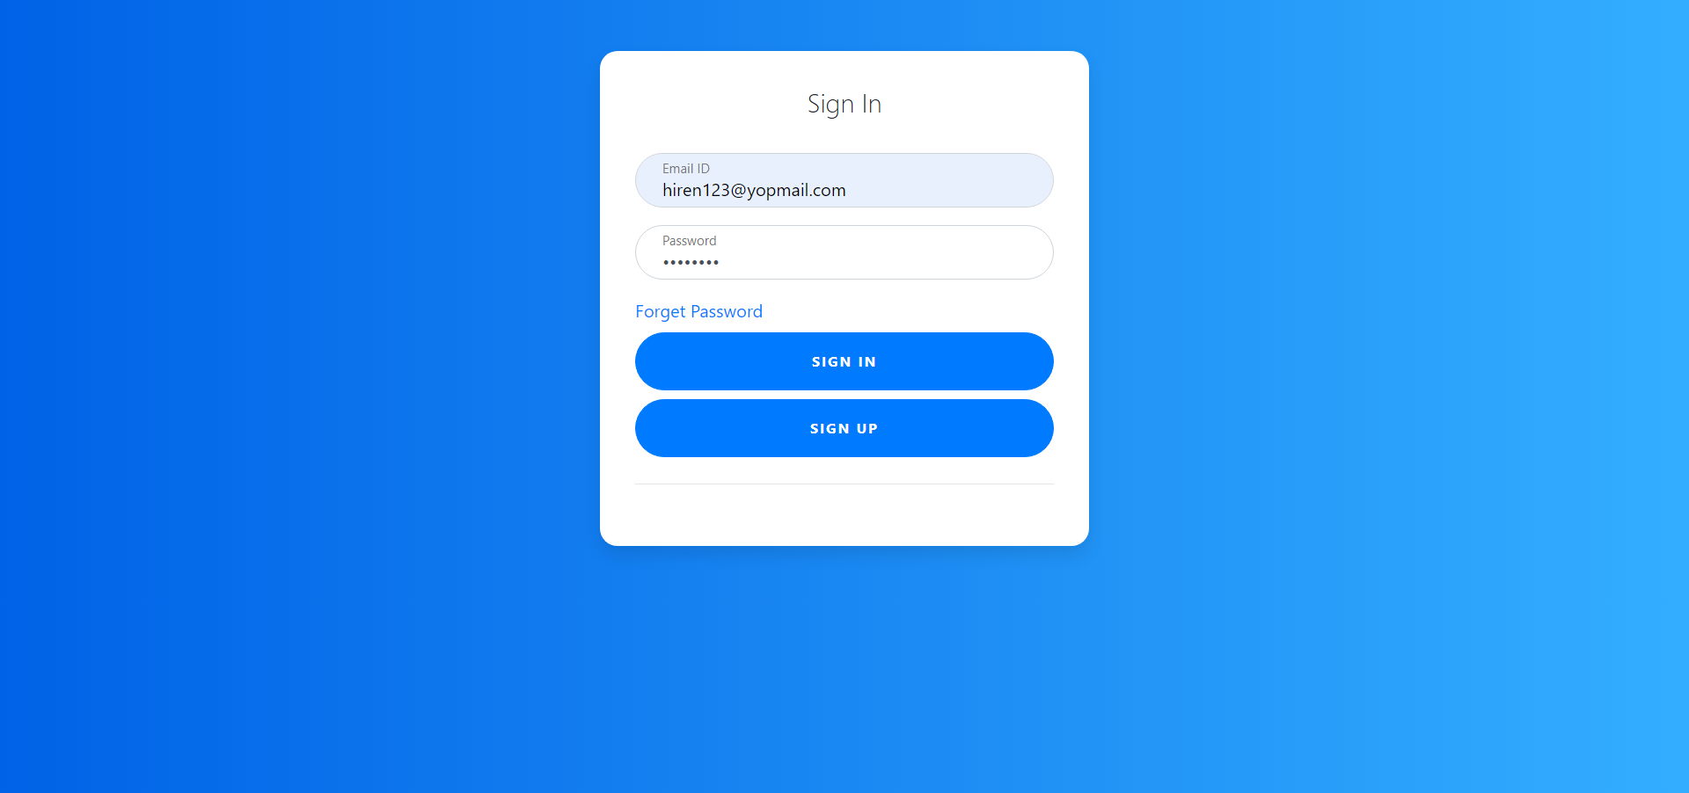
Login

Slide 65
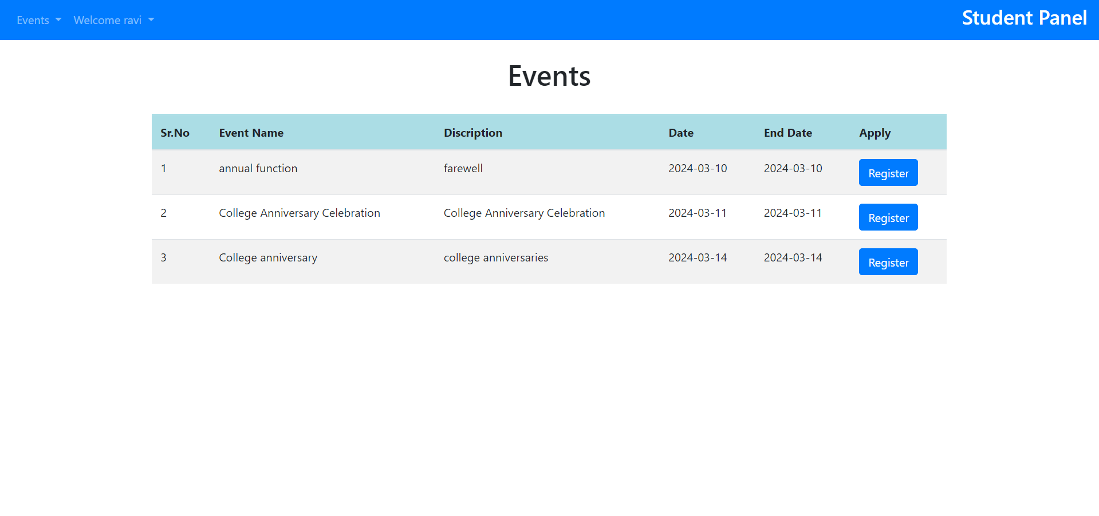
View All Events

Slide 66
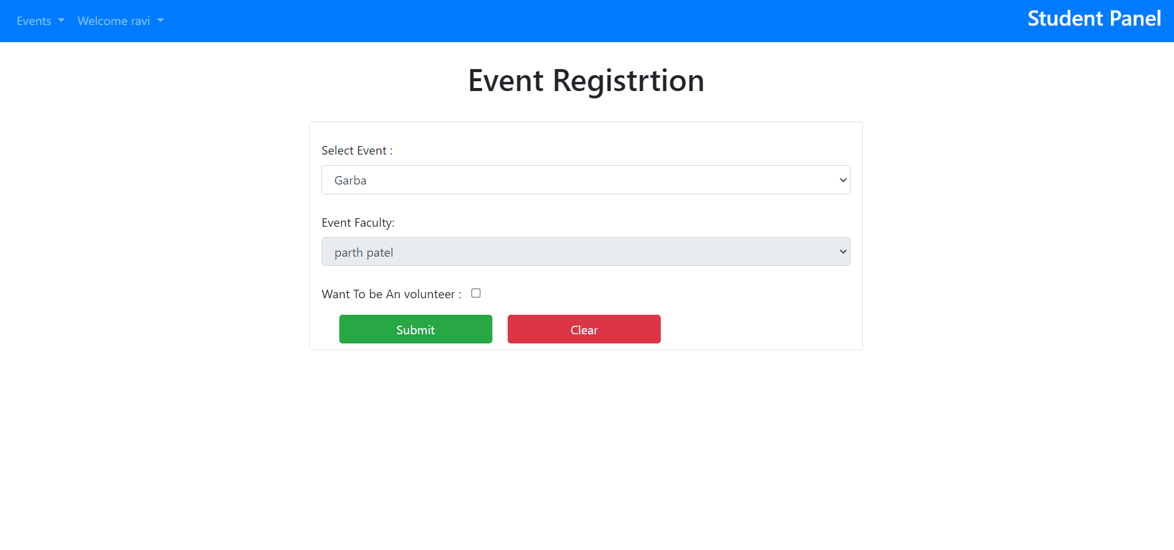
Event Registration

Slide 67
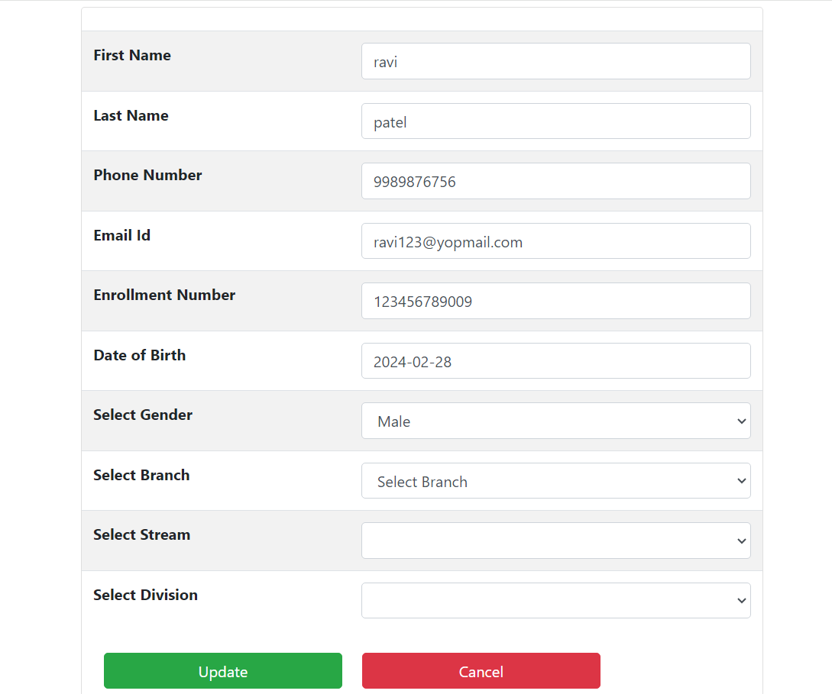
Update Student Profile

Slide 68
Event Registration

Slide 69
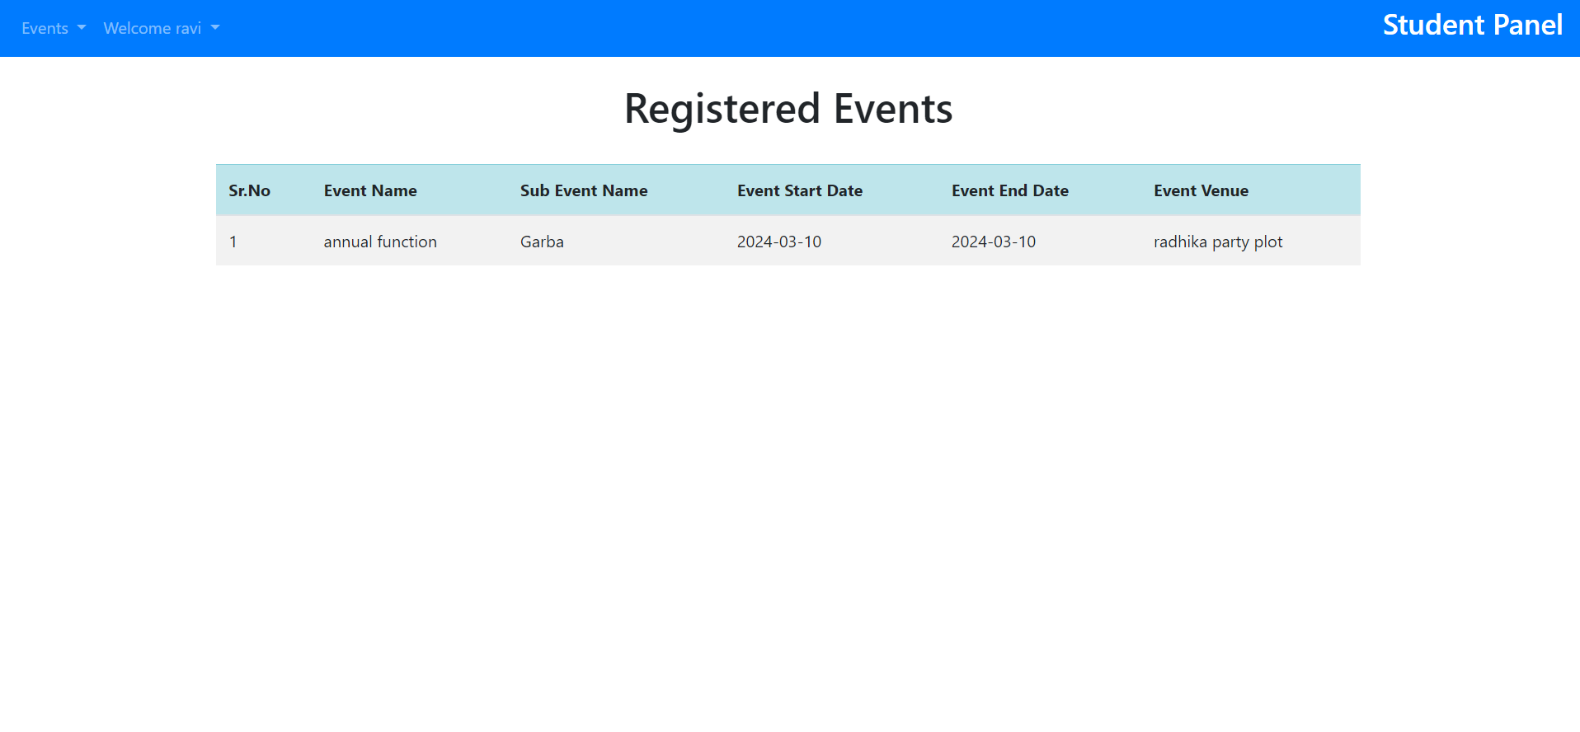
Registered Events

Slide 70
ADVANTAGES AND DISADVANTAGES

Slide 71
Advantages
Event Scheduling Completed within couple of minutes.
To Maintain events records yearly.
Practice session notification to all registered student.
Overcomes the dependency of a single person handling all the activities.
Student can register from anywhere not necessary to come college.
Automating various aspects of event planning and execution streamlines processes, saving time and reducing manual errors.
By optimizing resources and reducing manual labor, an event management system can lead to cost savings in terms of time, effort, and resources.
Features like online registration, interactive event pages, and attendee feedback mechanisms can enhance participant engagement and satisfaction.

Slide 72
Disadvantages
Requires an active internet connection.
Event Handler cannot add expenses.
Implementing an event management system may require significant initial setup and configuration, including integration with existing systems, which can be time-consuming and complex.
Like any software system, event management platforms may encounter technical glitches, downtime, or compatibility issues, potentially disrupting event planning and execution.
Reliance on technology for event management makes the system vulnerable to issues such as system failures, internet connectivity issues, or cybersecurity threats.
Users may require training to familiarize themselves with the system's features and functionalities, especially if they are not tech-savvy, which can entail additional time and resources.

Slide 73
System enhancement
Real-Time Collaboration
Mobile Optimization
Integration with External Platforms
Customizable Registration Forms
Automated Email Communication
Resource Management
Advanced Reporting and Analytics
Enhanced Security and Compliance
Feedback and Surveys

Slide 74
conclusion
Event management is a glamorous and exciting profession which demands a lot of hard work and dynamism. As the name suggests, it means conceptualizing, planning, organizing and finally executing an event. It offers enormous scope for ambitious young people.
Event management is the planning and implementation of events, large and small that meet the marketing goals of an organization. Event management is an area that is growing rapidly, and is expected to have a better growth rate in the next decade. Typical events organized by institutes include sporting events, competitions, concerts and festivals.

Slide 75
references
https://stackoverflow.com/
https://laravel.com/docs/6.x
https://www.wikipedia.org/
https://www.freecodecamp.org/news/tag/laravel/
https://github.com/

Slide 76
Thank you

